Slide 1
Medical Surgical Prime Vendor (MSPV)
Prime

Slide 2
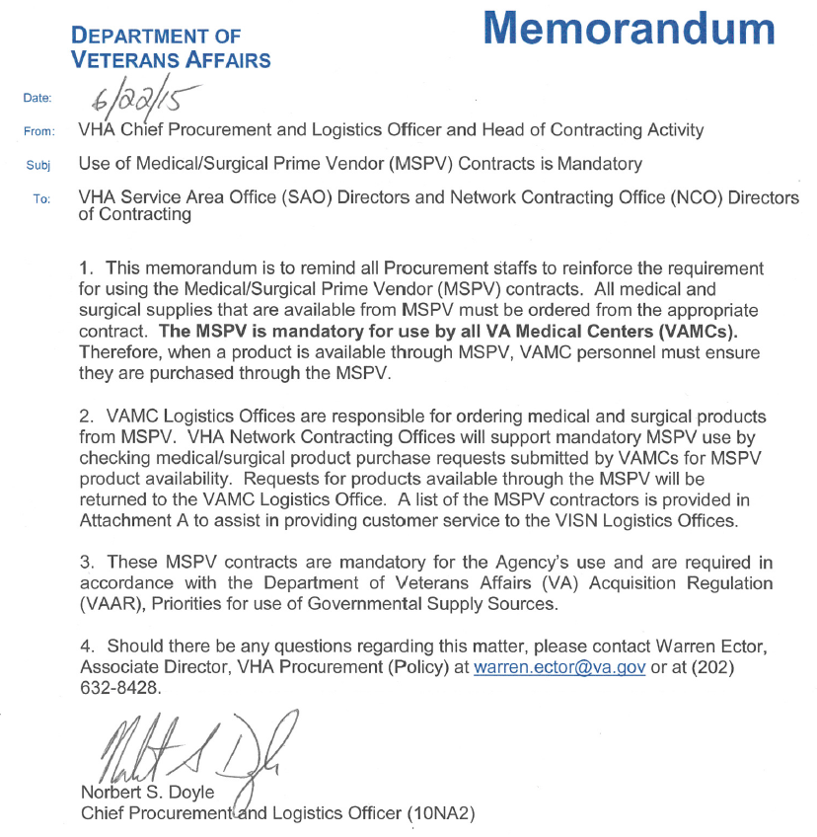
VHA MSPV Mandatory Policy Memorandum
Notes:
VHA MSPV Mandatory Policy Memorandum (6/22/15): Mandatory Policy for the Facilities from Chief Procurement and Logistics Officer.

Slide 3
What is the NG-MSPV Program?
NG-MSPV is a national mandatory program that provides a customized distribution system to meet or exceed facility requirements by providing an efficient, cost-effective, just-in-time distribution catalog ordering process via prime vendor contracts.
The NG-MSPV Primes will each maintain a catalog consisting of an inventory of supplies contracted by VA with a multitude of other contractors via a variety of VA contract vehicles that include BPAs, BOAs and National Contracts. NG-MSPV Catalog items will include medical, surgical, dental and select prosthetic and laboratory supplies.

Slide 4
Appendix C Overview
    These standard format data elements and fields are described in Appendix C.
    The Appendix C is a list of 55 standard data elements required to included Candidate items into the MSPV Catalog.
    Each solicitation that will be a candidate of NG-MSPV shall have an Appendix C attached to it when it is posted.
    Each Award that has been approved under the previous MSPV Contract shall have a completed Appendix C for each awarded line item in order to be enrolled in the NG-MSPV.

Slide 5
NG-MSPV Catalog
Solicitation Process

Slide 6

Volume I
Technical (Product Literature review)
Volume II
Price (Attachment D, Pricing Schedule)
Volume III
A Complete Offer
Solicitation, Offer, & Award Documents
NG-MSPV Requirement
Appendix C
Notes:
Offerors shall be a VA FSS holder for Schedule 65 and/or 66 by the date and time for receipt of offers/quotations. Late quotes may be accepted at the discretion of the contracting officer. The Offeror’s quote shall be submitted electronically by the date and time indicated in block 8 of the SF 1449, via email to: MSPVTeamEmailInbox@va.gov, as set forth below. The Offeror’s quote shall consist of and be submitted in the following three (3) Volumes:
Volume I – Technical (Product Literature review)
Volume II – Price (Attachment D, Pricing Schedule)
Volume III – Solicitation, Offer, & Award Documents

Slide 7
NG-MSPV Catalog
Solicitation Process
All contract vehicles will generally be competed BPAs, BOAs, National Contract and Contracts resulting in single award.
  Solicitation closing dates will generally be a standard 30 day response time.
  NG-MSPV Catalog will be populated by Appendix C
Notes:
Here is our Process

Slide 8
NG-MSPV Catalog
Solicitation Process-Continued
Two Different Methods of Solicitation
  VA FSS Schedule 65 and 66
    Full and Open
  Open Market
    Small Business Set-Asides for Manufacturers
    Non-Manufacturer Waivers
      Cascading Approach
        SDVOSB, VOSB, SB, and LB
      Both Manufacturers and Distributors may propose

Slide 9
NG-MSPV Catalog
Solicitation Process-Continued
Each RFQ will provide language advising potential Quoters of the following:
  Contract Line Items selected for inclusion in each BPA shall meet the (salient) characteristics prescribed by the Program Office.
  Selection methodology will generally be on a “Low Price” basis, however, the Government reserves the right to use other methods as deemed appropriate.
Notes:
This slide needs to speak to what is needed to be successful for their quote. For Example…Completed Price Sheet, Appendix C, Product Literature, and etc

Slide 10
Projected Solicitations
Release Schedule
Solicitation Issued Phase | Date
FSS - #7 | 11/04/15
FSS - #8 | 11/24/15
Non-FSS - #1 | 11/04/15
Non-FSS # 2 | 12/11/15

Slide 11
Acronyms
Attachment 1
SAC | Strategic Acquisition Center (Location: Fredericksburg, VA)
NAC | National Acquisition Center (Location: Hines, IL)
FBO | Federal Business Opportunities (FedBizOpps)
VA-FSS | VA Federal Supply Schedule (FSS) program
MSPV-NG | Medical Surgical Prime Vendor – Next Generation
VHA PMO | Veterans Health Administration – Program Management Office
GSA-FSS | General Services Administration – Federal Supply Schedule
FAR | Federal Acquisition Regulation
VA | Department of Veteran Affairs
NVSBE | National Veterans Small Business Engagement

Slide 12
Awarded Strategic Contracts (SAC and SAC-F) Attachment 2
The following link provides information concerning the SAC and SAC-F Strategic BPAs/Contracts that have been previously awarded:
Copy of SAC_SAC F Strategic Contract Awards (FY12-15)2.xlsx

Slide 13
Summary
Future MSPV will streamline and improve ordering efficiencies throughout VA’s Medical Community by:
- Providing enhanced flexibility and ease of ordering for both
VA’s Customers and Ordering Officers
- Reducing the number of purchase orders
- Reducing the number of shipments and resultant invoice
procedures
- Reducing VA’s inventory levels (thereby freeing up valuable
VA inventory space)
To fulfill President Lincoln's promise “To care for him who shall have borne the battle, and for his widow, and his orphan” by serving and honoring the men and women who are America’s Veterans.

